Slide 1
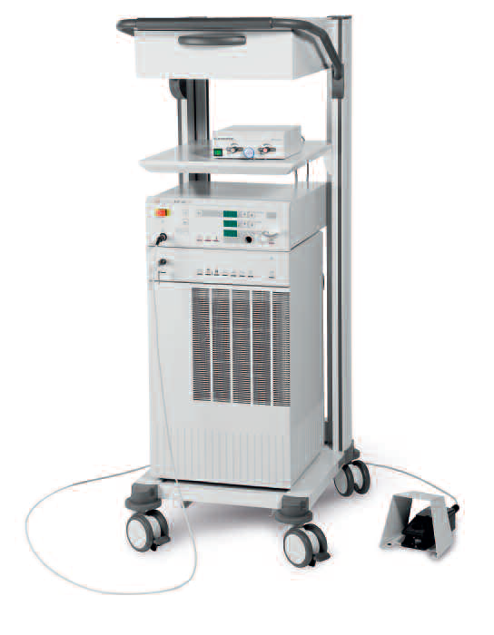
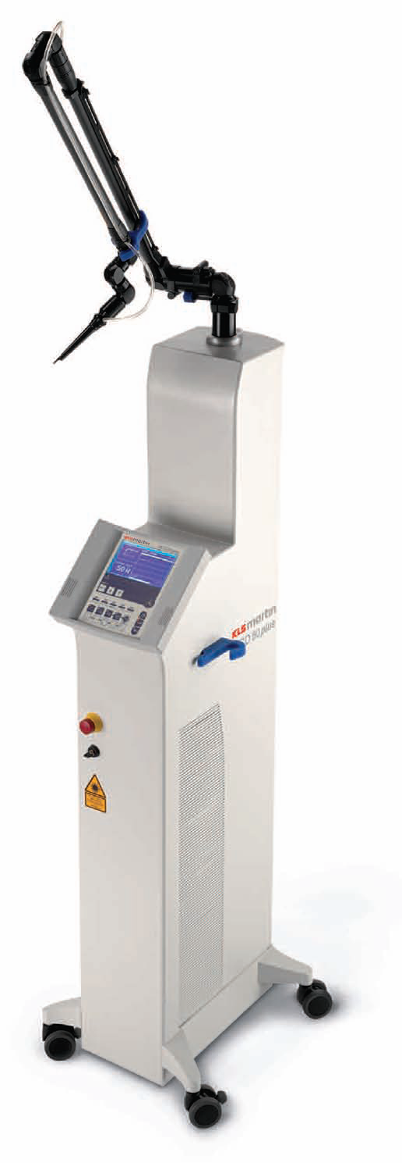
MEDICAL LASER SYSTEMS
Assist Prof. Dr. Lutfi Ghulam Awazli
Institute of laser for postgraduate studies
University of Baghdad

Slide 2
Spatial and Temporal Characteristics of Laser Beam

Slide 3
Parameters of Laser Radiation:
Wavelength (nm) : Absorption + Depth of Penetration
Power( P ): The rate at which the energy is delivered (W)
Exposure time (t) :
Pulse duration, (s)
Energy( E )= P x t
Spot size (cm).
Power Density (Irradiance)=P/A (W/cm²)
Energy density (Fluence)= E/A (j /cm²)
PRR is the pulse repetition rate,( i.e: number of pulses per second )

Slide 4
Spatial Characteristics of Laser Beam

Slide 5
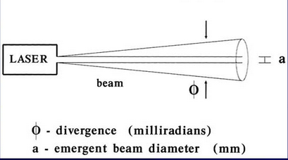
SPATIAL CHARACTERISTICS OF LASER BEAM
BEAM DIVERGENCE:
Beam divergence is the angular measure of the increase in the beam diameter or radius with distance from the optical aperture as the beam emerges.

Slide 6
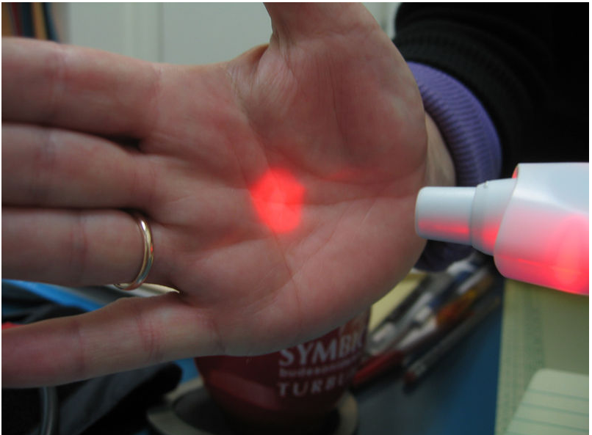

Slide 7
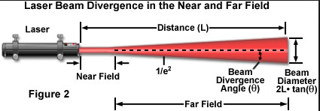

Slide 8
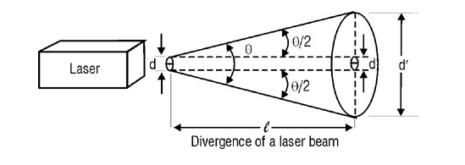
The light emitted by a laser is confined to a rather narrow cone; but, as the beam propagates outward, it slowly diverges or fans out. Figure below, illustrates the way in which a beam of circular cross-section diverges.
At the output aperture of the laser, the beam diameter is d. Its beam divergence angle is θ, In traversing a distance ɭ the beam diverges to a circle of diameter ď. for a small divergence angle, the diameter of the beam at a distance from the output aperture is approximated by Equation below.
ɭ = Distance from laser output aperture to measurement position. θ = Full-angle beam divergence in radians or miliradians. d = Initial beam diameter at output aperture. ď = Beam diameter at measurement position

Slide 10
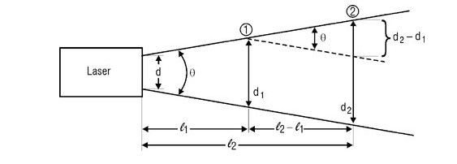
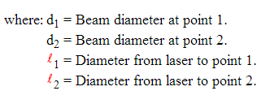
MEASURING BEAM DIVERGENCE :
The divergence of a laser beam (CW laser ) can be calculated if the beam diameter at two separate distances are known d₁ and d₂.
The full angle beam divergence is given by Equation :

Slide 11
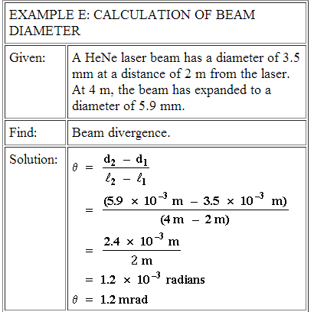

Slide 12
A typical He-Ne laser has an output beam with a diameter of 1 mm and a divergence of 1 mrad. What is the diameter of the beam at a distance of 10 m?

Slide 13
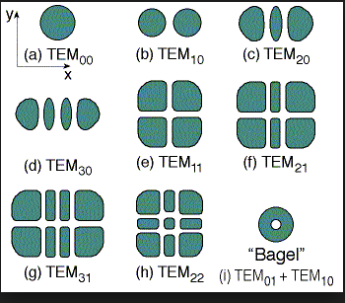
TRANSVERSE ELECTROMAGNETIC MODES," OR "TEM MODES”
TEM Modes describe the shape of energy distribution in the beam cross section.
Figure 1 illustrates the irradiance patterns produced by lasers operating in various transverse modes. The general mode is specified as TEM_{mn} , where :
m = Number of points of zero illumination (white areas in Figure 1 between illuminated regions) crossing the horizontal ( x ) axis.
n = Number of points of zero illumination (white areas in Figure 1 between illuminated regions) crossing the vertical ( y ) axis.
Thus, TEM₂₁ (Figure 1f) has two vertical bands (shown as white) crossing the x­axis and one horizontal band (shown as white) crossing the y­axis.
The dark areas mark places where laser radiation hit ( illuminated regions).
Fig. 1 Various Transverse electromagnetic modes

Slide 14
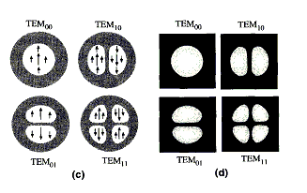
The laser cavity length and the wavelength of the light interact to produce longitudinal modes of energy distribution in the beam, but the resonator design is a key factor in determining the intensity distribution across the width (Transverse diameter) of the beam, and the rate at which the beam diverges.
The intensity across the beam is determined by the transverse mode of the beam.
A typical laser beam is brightest in the center and drops off in intensity toward the edges. This represents the simplest first-order mode, is designated TEM(00), and has an intensity profile across the beam that follows a Gaussian function
m = Number of points of zero illumination (between illuminated regions) along x axis.
n = Number of points of zero illumination (between illuminated regions) along y axis.

Slide 15
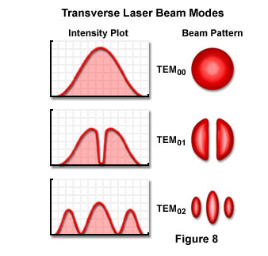
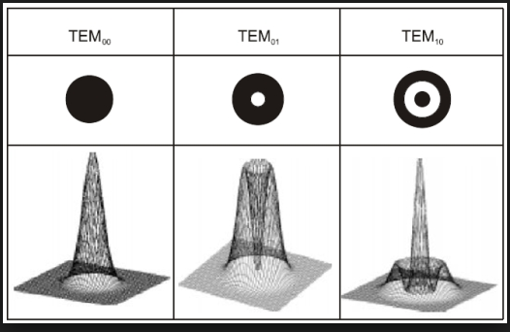
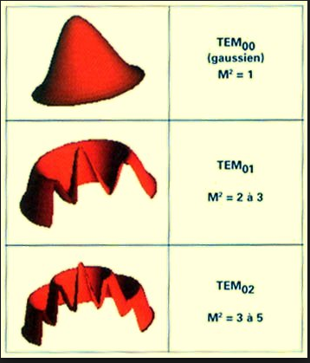
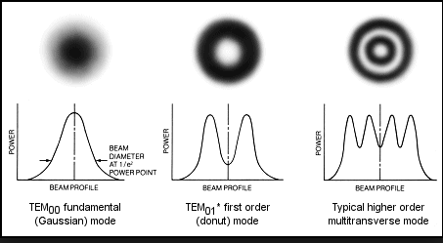
TEM Modes describe the shape of energy distribution in the beam cross section.

Slide 16
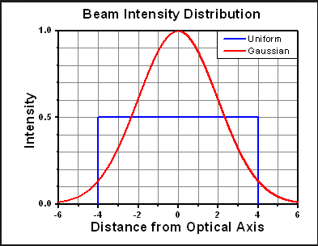
The basic transverse mode has properties which makes it very practical, and laser manufacturers try very hard to build lasers which operate in single basic Gaussian mode. (i.e, Most lasers are designed to operate in TEM₀₀ mode only.
TEM₀₀ is termed the " uniphase or pure Gaussian mode or the basic transverse mode " because it is the only transverse mode in which all the light is in one phase at any given time(all the radiation is in phase and spatially coherent along the cross section of the beam) , resulting in the following important characteristics of this mode:
It has a lowest divergence angle than all other transverse modes. Lower divergence is important in the transmission of beams over large distances, as, in laser ranging.
It can be focused to the smallest spot than all other transverse modes ( smallest effective beam diameter and hence the highest power intensity). This is important in an application such as drilling and incisional applications because it provides the minimum possible desirable effective diameter of the focused laser beam at the focal plane.
Its spatial coherence is ideal for applications that depend upon the interference of light. Other modes cannot be used because they lack adequate spatial coherence.
The imaging with a lens of a Gaussian beam, and other optical elements which the beam pass through, creates again a Gaussian beam.

Slide 17
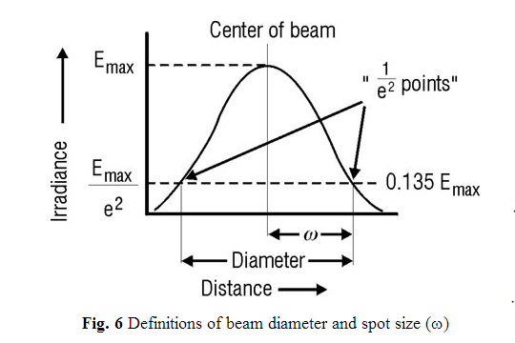
BEAM DIAMETER AND SPOT SIZE
Figure 6 indicates the profile of a TEM₀₀ laser beam. the irradiance of the beam decreases gradually at the edges, specification of beam diameter out to the points of zero irradiance is impractical.
The "beam diameter" is defined as "the distance across the center of the beam for which the irradiance (E) equals 1/e² of the maximum irradiance (1/e² = 0.135).
The "spot size" (w) of the beam is "the radial distance (radius) from the center point of maximum irradiance to the 1/e² point." These definitions provide standard measures of laser beam size.

Slide 18
Spot diameter:
It is the diameter of the irradiated area on the target.
The spot diameter is considered to be equal to the beam diameter when the lenses are not be used. Using focusing lenses could change this area.
The spot diameter (2W₂) is directly proportional to the focal length of the lens (F) and the laser wavelength (λ) .
The units of the spot diameter are usually centimeters.

Slide 19
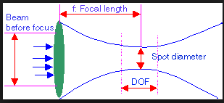

Slide 21
Temporal Characteristics of Lasers

Slide 22
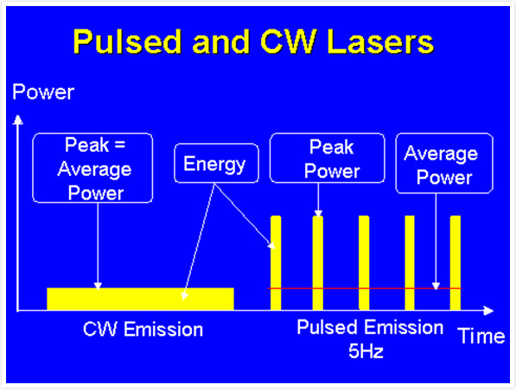
TEMPORAL CHARACTERISTICS OF LASER BEAM
According to the mode of laser operation; lasers can be divided into three types:

Slide 23
According to the mode of laser operation; lasers can be divided into three types:
CW or continuous mode:
A CW laser is one whose power output undergoes a little or no fluctuation with time (the laser output can be maintained uninterruptedly).
Continuous Output (CW)
It exhibits a steady flow of coherent energy.
Here the most important parameter is the power in the unit of Watt; it’s a measured parameter.
Also we have Power Density in which it represents the measured power per unit area.
Power (Watts)
( Power Density= power / area …….( watt/ cm²
Time
Continuous lasers (as gas lasers : He:Ne or CO₂ laser)

Slide 24
Chopped mode laser :
A shutter may interrupt The output of a CW laser that chops the beam into trains of short pulses. The maximum power level of each pulse is the same as that obtained in the CW mode. The duration of the pulse when the shutter is open is limited by the speed of the shutter and is typically 100 to 500 m sec. The useful proportion of the laser beam during which the light is transmitted by the chopped laser is called Duly Cycle (DC):
The duty cycle is obtained by multiplying the pulse width by the frequency (in hertz) (Al-Qalamjy, 2001).

Slide 25
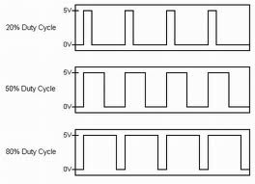
What is Duty Cycle :
It represents the fractional amount of time the laser is on during any given period
Duty Cycle = Ϯ / T * 100
Where Ϯ is the pulse duration and T is the period
Duty Cycle = Average power / Peak power * 100

Slide 26
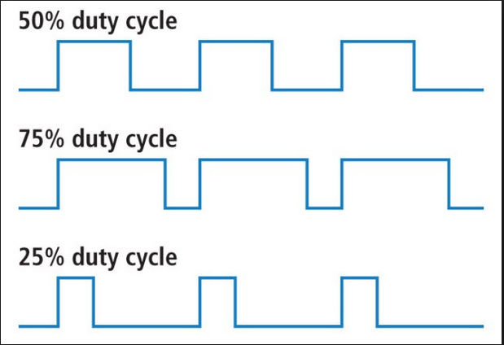

Slide 27
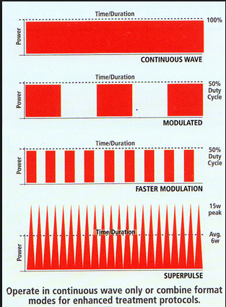

Slide 28
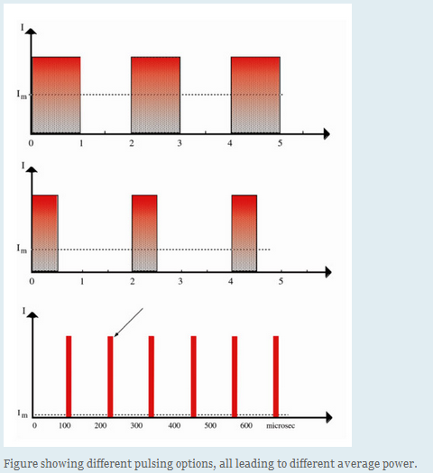

Slide 29
Pulsed lasers :
A group of lasers has an output beams that undergo marked fluctuations that is the beams power changes with time in a very noticeable fashion.
Pulsed laser operation may be further subdivided according to pulse length and methods for producing such pulses. The following are the basic operating modes for pulsed lasers:
Normal pulsed mode.
Q-­switched mode.
Mode locked.
Pulsed Output (P)
Energy (Joules)
What is energy density (Fluence)?
Fluence = Energy/Area ……. ( J/ cm²)
What is the Dose:
represent the whole energy deposited inside the tissue.
Dose = E _{pulse} / area * no. pulses … ( J/ cm²)
Time

Slide 30
What is Peak power :
P _{peak} = E _{pulse} / Ϯ _{pulse} …… (J/s or W)
What is Average power:
P _{ave} = E _{pulse} * PRR or E _{pulse} / PRT …( J/s or W)
What is Pulse Repetition Rate (or pulse repetition frequency) f_{rep} The number of emitted pulses per second.
PRR = Number of pulses / second …….. (1/s or Hertz )
What is Pulse-repetition time (PRT)
The time between the beginning of one pulse and the start of the next pulse and is equal to the reciprocal of PRF as follows:
PRT = 1/ PRR …….. ( s )

Slide 31
Pulse Duration
Pulse duration, t, is the length of time in microseconds ( sec or 10⁻⁶ s) that a pulse is transmitted. The pulse duration of the WSR-88D in short pulse mode (VCP 11, 12, 21, 121, 211, 212, 221, or 32) is 1.57 sec. Multiplying pulse duration by the speed of light (c = 3 x 10⁸ m/s) produces a pulse volume whose pulse length, H, is ~ 500 m. In long pulse mode (VCP 31), the pulse duration is 4.7 sec producing a pulse length, H, of ~ 1500 m (4,625 ft). In long pulse mode, the total power received from a given target would correspondingly be three times greater than in short pulse mode. As a result, the WSR-88D is more sensitive when operating in long pulse mode than in short pulse mode.
The terms long pulse and short pulse should not be confused with the Pulse Repetition Frequency (PRF) or Pulse Repetition Time (PRT). Pulse duration is independent of the PRF (or PRT) and only describes how long the radar stays on while transmitting a pulse, whereas the PRF (or PRT) determines how often the radar transmits pulses.

